Slide 1
The Enigma Simulator
Elliot Brooks
Notes:
Hello, my name is Elliot and this is the screencast about my project : The Enigma Simulator.

Slide 2
In this video :
Motivation & Context
Aims
Enigma Roleplay
Notes:
In this video, I will cover the motivation and context surrounding this project – provide the aims of project – as well as provide a demonstration of the project through roleplay

Slide 3
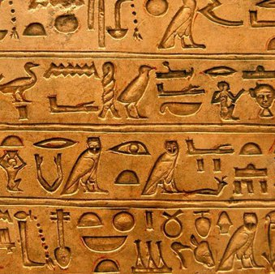

Is this you?
Secret messages?
Protected Data?
Cryptography!
Since 1800 BCE
Notes:
Before we begin, let me ask you a question : Have you ever wanted to keep your messages? Or ensure that your personal data is kept secret? If the answer is yes, then you are not alone!
Cryptography is the art of creating and breaking secret codes and has been used for data protection and secret communications throughout history. Dating all the way back to 1800 BCE!

Slide 4
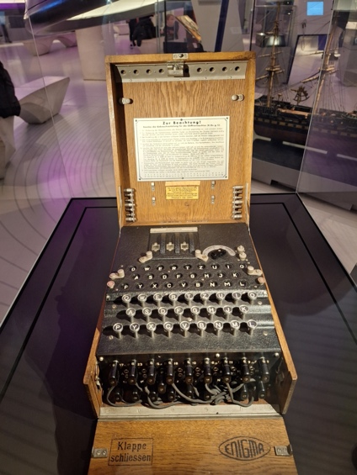
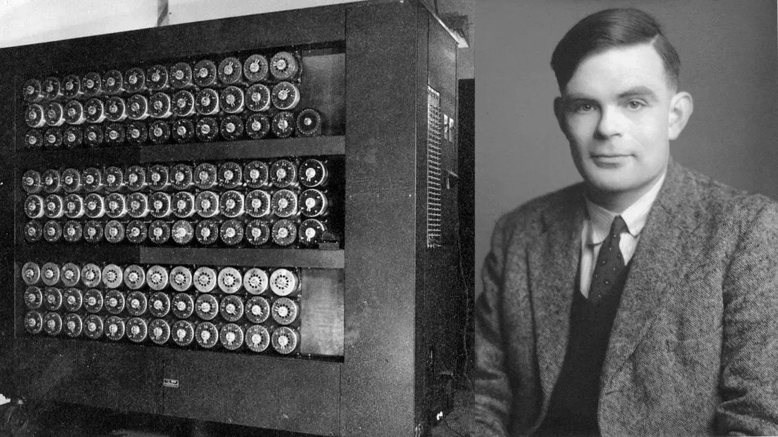
The Enigma Machine
History
A Cypher Machine
Mechanical rotors
Electrical Signals
Encrypts/Decrypts messages
Extensive History
Used by Germans in WW2
Cracked by the Bletchley Park team!
Notes:
The Enigma machine is one of the most famous cypher machines in the world, making use of mechanical rotors and electrical signals to encrypt and decrypt messages
The Enigma machine was a huge part of cryptography, history and computer science.
It was used extensively by the Germans in WW2 and is most well-known for the eventual breaking of Enigma by Alan Turing and the team at Bletchley Park. Which helped turn the tides of the war for the Allies.

Slide 5
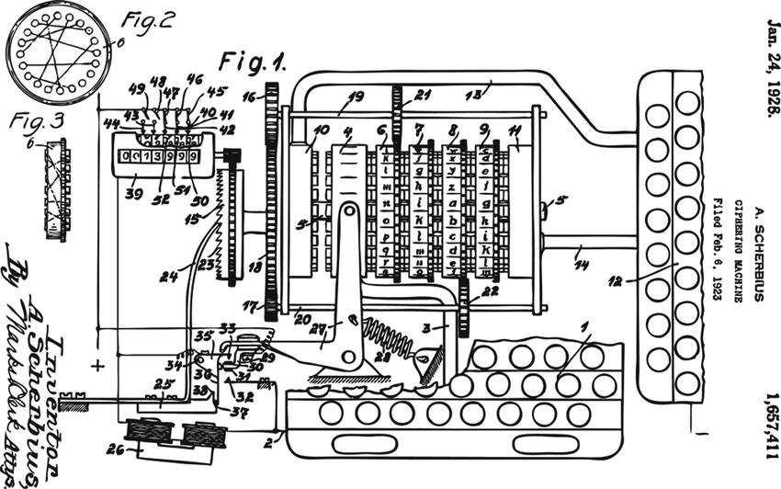
?
?
?
Notes:
Whilst most have heard of the machine either through history, cryptography, or even filmography! The mechanism and workings of the machine still remain a mystery/enigma to most people

Slide 6
How does Enigma work?
Electrical Signals
Mechanics
Keyboard
Plugboard
3x Rotors
Reflector
Lampboard
Rotors rotate every keypress
Causing wiring to change
Causing letter mapping to change
One letter can be encrypted to multiple different letters in a single message!
Up to x9 letter scrambling!
Notes:
So how does Enigma work? Well, it uses a combination of mechanics and electrical signals to create a cypher than changes for each letter in a message!
The electrical signals are passed through 5 key components : A keyboard for input, A plugboard to acting as a swap cypher, 3 rotors which act as substitution cyphers and exhibit additional mechanical properties, a reflector which also acts as a substation cypher “reflecting” the electrical signal in the opposite direction, and finally the lampboard to display the cyphertext
The mechanics behind enigma cause the rotors to rotate each keypress, this changes the path each electrical signal will take through Enigma, therefore inducing a change in the letter-to-letter mapping of the cypher.
This creates a unique effect, where one letter can be encrypted to multiple different letters in a single message.

Slide 7

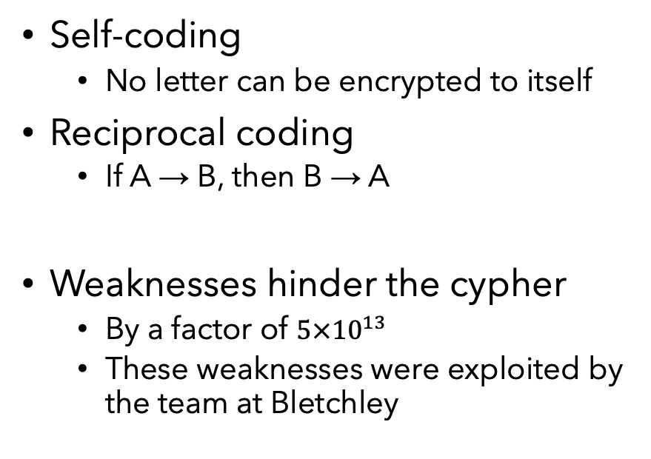
Enigma is Unbreakable!?
Enigma’s Complexity
Enigma’s Flaws
Unpredictable mechanism
Large theoretical key-space
$3×{10}^{114}$ different Enigma settings (480 bits)
Self-coding
No letter can be encrypted to itself
Reciprocal coding
If A → B, then B → A
Weaknesses hinder the cypher
By a factor of $5×{10}^{13}$
These weaknesses were exploited by the team at Bletchley
Notes:
With all these different settings and mechanisms, surely Enigma is unbreakable! This can’t be the case!
Enigma was a complex machine, creating an unpredictable mechanism that was difficult to understand, as well as boasting a large theoretical key-space of nearly
If that’s the case, then how was this cracked on a daily basis with the technology at the time?
Enigma also had crucial flaws. The first of which was Self-coding (no letter can be encrypted to itself). In addition, the Enigma’s symmetrical design created Reciprocal Coding, which means encrypt and decrypt are the same operation!
These weaknesses greatly affected the Enigma, and were key weaknesses that were exploited by the code breakers. If only there was a way around these weaknesses…

Slide 8
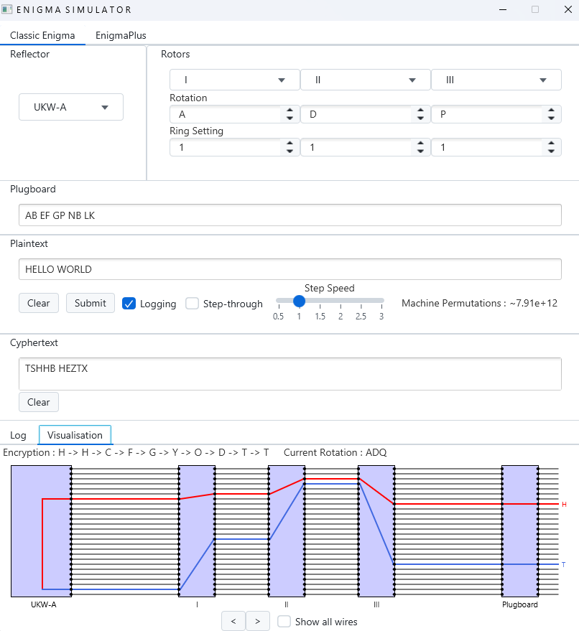
What is The Enigma Simulator? (Aims)
Accurate recreation of Enigma
Allow the user to create custom components
An improved model “EnigmaPlus”
Fixes the flaws of Enigma
Quick and easy to use command line interface
Informative and educational GUI
Includes real-time visualisation tool!
Notes:
So what is the goal of this project? Well, it is clear that Enigma an important and complicated machine, and this project aims to help other inspired individuals learn more about it!
Firstly, the project provides an accurate recreation of Enigma, allowing decryption of GENUINE messages from WW2
It provides a new model, similar to Enigma, called EnigmaPlus. Which behaves differently to provide a stronger cypher than the original Enigma
A quick and easy-to-use command line interface, allowing simple interaction with Enigma
A much more interactive and educational GUI based on the MVC Architecture, allowing interactions with both Enigma and EnigmaPlus
Within this GUI exists a visualisation tool, so you can see how the machine is hiding encrypting your message!

Slide 9
Let's use Enigma! (Live Demo)
Notes:
Now you know what the project is about, lets give it a go with some roleplay!
You have just got the promotion at the Cryptography Ltd. Congratulations! Your first task is to use the state-of-the-art Enigma Simulator to decrypt an incoming message…
Alongside your strange message, you notice a sheet containing various different attributes that seem to match the simulator in front of you.
Lets begin with trying to set up our Enigma in the same way suggested on this sheet
Firstly, it says the reflector choice is UKW-B so lets use this drop down to select the correct rotor
Next, lets choose the correct rotors. The message says rotor one, two and then three. Lets select these rotors whilst preserving their order as this makes a big difference!
Whilst we’re here, lets set up the rotors to the correct configuration. The message key states ADP, which was shorthand notation for the Rotation of each rotor so lets change that. Next the ring setting for each rotor is stated as 5 11 and 22 so lets change them
The final setting we need to configure is the plugboard, which consists of choosing which pairs of letters will be swapped, in this case we have AB GP and UV
Now that our Enigma machine is setup, lets enter our message and see what it says.
Oh look, it says I LOVE CRYPTOGRAPHY!
We can also use the app to visualise each step of the encryption and see how these letter mappings are decided. We can also use the step-through mode to the encryption through a simple animation
If we wanted to use EnigmaPlus, the top tab can be selected to change to this model, however this has a different key to Enigma so will not work with our current message.
Encryption Message : I LOVE CRYPTOGRAPHY!
MESSAGE : L AUZK VWCZBBVWEYME!
MESSAGE KEY : ADP
RING : 5 11 22
ROTORS : I II III
REFLECTOR : UKW-B
PLUGBOARD : AB GP UV

